Slide 1


Introduction to Simple Linear Regression
Simple linear regression is a fundamental machine learning technique used to model the linear relationship between a dependent variable and an independent variable. It helps us understand how changes in the independent variable affect the dependent variable.
Dependent Variable
Independent Variable
Relationship
The variable we are trying to predict or explain, often denoted as "y".
The variable used to predict or explain the dependent variable, often denoted as "x".
The goal is to understand how changes in the independent variable affect the dependent variable.

Slide 2
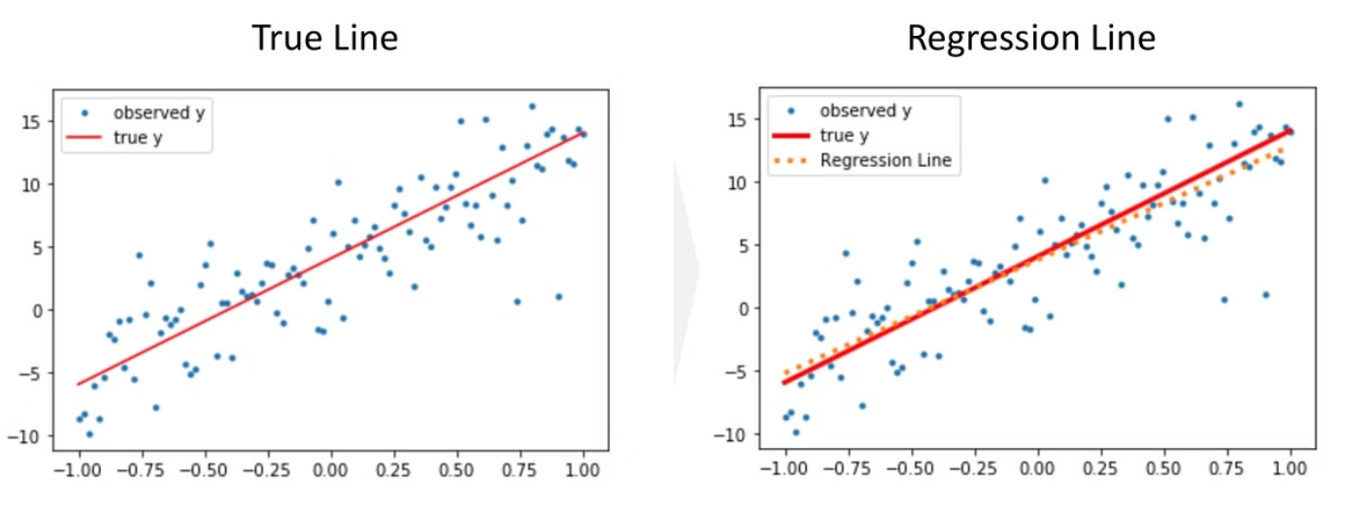

Slide 3
The Linear Regression Equation
Equation
Interpretation
Visualization
The linear regression equation is: y = a + bx, where "a" is the y-intercept and "b" is the slope.
The slope "b" represents the average change in the dependent variable "y" for a one-unit change in the independent variable "x".
The equation can be visualized as a straight line that best fits the data points.

Slide 4
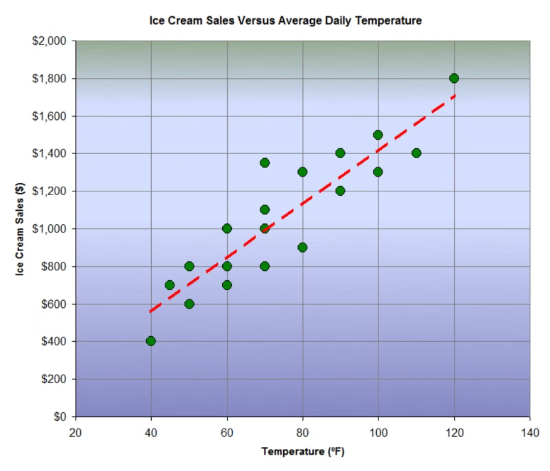

Slide 5
Estimating the Regression Coefficients
1
Least Squares Method
The coefficients "a" and "b" are estimated using the least squares method, which minimizes the sum of the squared residuals.
2
Matrix Algebra
The coefficients can also be calculated using matrix algebra, which provides a more general and flexible approach.
3
Statistical Software
In practice, statistical software packages like R, Python, or SPSS are used to efficiently compute the regression coefficients.

Slide 6
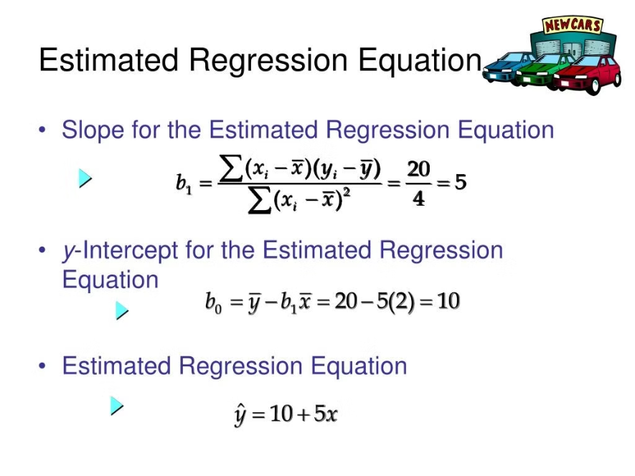

Slide 7
Evaluating the Model Fit
1
R-squared
2
Statistical Significance
3
Residual Analysis
The coefficient of determination (R-squared) measures the proportion of the variance in the dependent variable that is predictable from the independent variable.
Examining the residuals (the difference between the observed and predicted values) can reveal patterns and help assess model assumptions.
Hypothesis tests, such as the t-test and F-test, are used to determine if the regression coefficients are statistically significant.

Slide 8
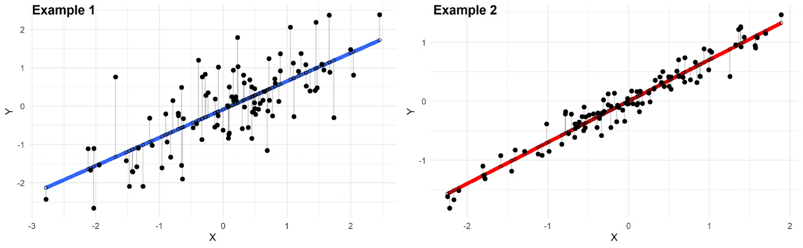

Slide 9




Assumptions of Linear Regression
Linearity
Normality
Homoscedasticity
Independence
The relationship between the dependent and independent variables should be linear.
The residuals should follow a normal distribution.
The variance of the residuals should be constant (homogeneous).
The residuals should be independent of each other.

Slide 10



Interpreting the Regression Results
Coefficient Interpretation
The regression coefficients, "a" and "b", can be interpreted in the context of the problem to gain insights.
Statistical Significance
The p-values associated with the coefficients indicate the likelihood that the observed relationship is due to chance.
Model Fit
The R-squared value and residual analysis provide an overall assessment of how well the model fits the data.

Slide 11
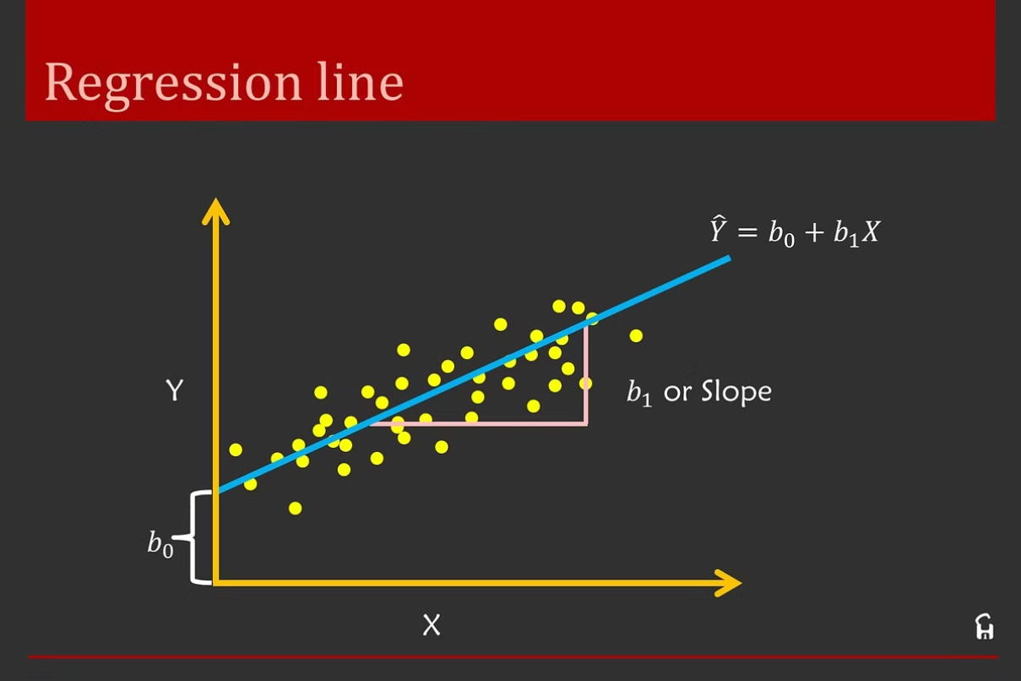

Slide 12
Applications of Simple Linear Regression
Predicting Sales
Forecasting Demand
Estimating Energy Consumption
Analyzing Housing Prices
Evaluating Marketing Campaigns
Studying the Relationship between Variables
Assessing the Impact of Policies
Understanding Consumer Behavior

